Slide 1
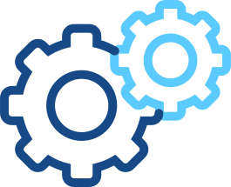
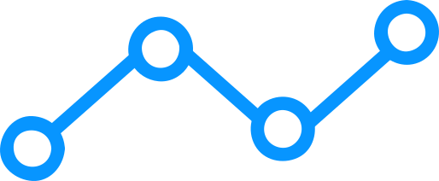

Operating System
Motherboard

Slide 2

TABLE OF CONTENTS
01
DEFINITION OF MOTHERBOARD
02
COMPONENT OF MOTHERBOARD
03
CONCLUSION

Slide 3
01
DEFINITION OF
MOTHERBOARD

Slide 4

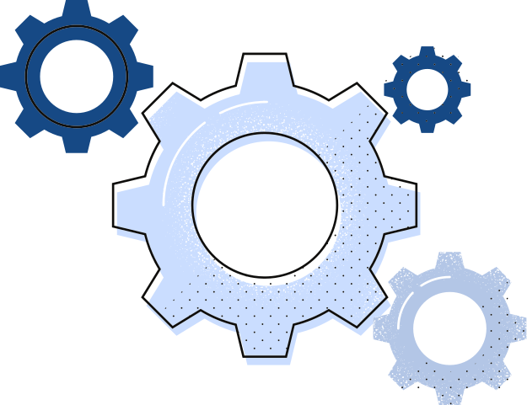
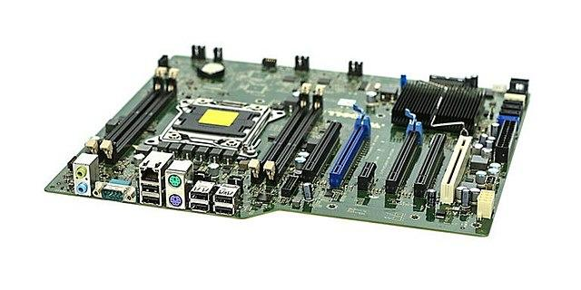
DEFINITION OF MOTHERBOARD
MOTHERBOARD
Motherboard is the central circuit board in a computer, providing electrical and mechanical connections between components.

Slide 5
02
COMPONENT OF MOTHERBOARD

Slide 6
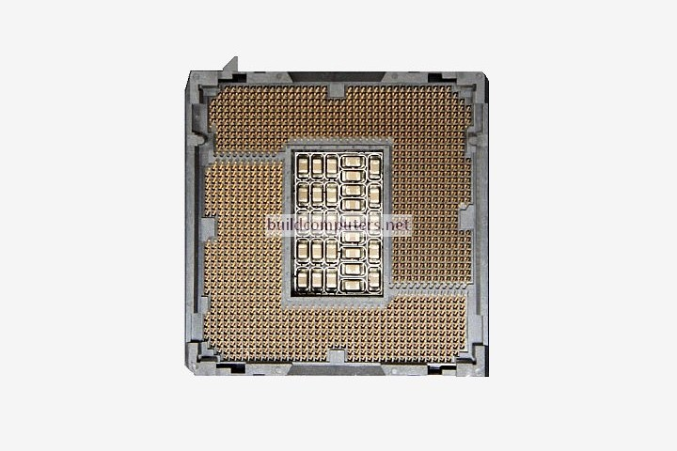
CPU Socket
This is where the central processing unit (CPU) is inserted. The CPU is the brain of the computer and performs all the necessary calculations and computations.

Slide 7
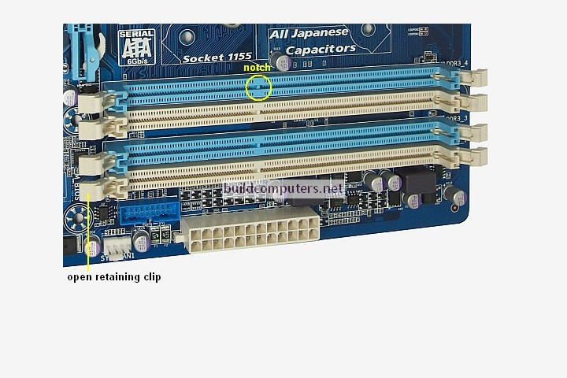
RAM Slots
Random Access Memory (RAM) is used to temporarily store data that the CPU needs to access quickly. The RAM slots are where you insert the RAM modules.

Slide 8
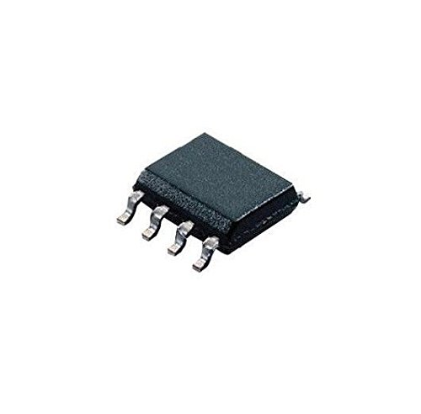
BIOS Chip
This chip stores the Basic Input/Output System (BIOS), which is responsible for initializing the hardware and software during the boot process.

Slide 9
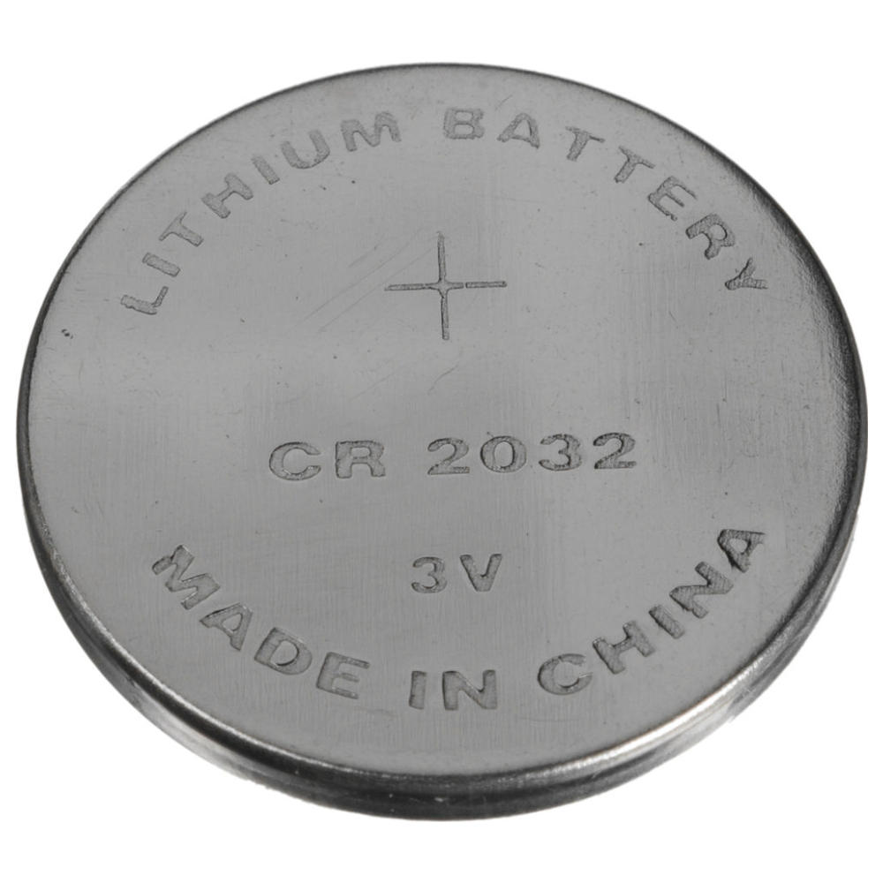
CMOS Battery
This battery powers the CMOS memory, which stores the BIOS settings and the system clock.

Slide 10
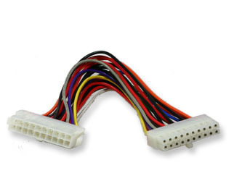
Power Connectors
The power connectors are where you attach the power supply cables. The power supply provides power to all the components on the motherboard and in the computer.

Slide 11
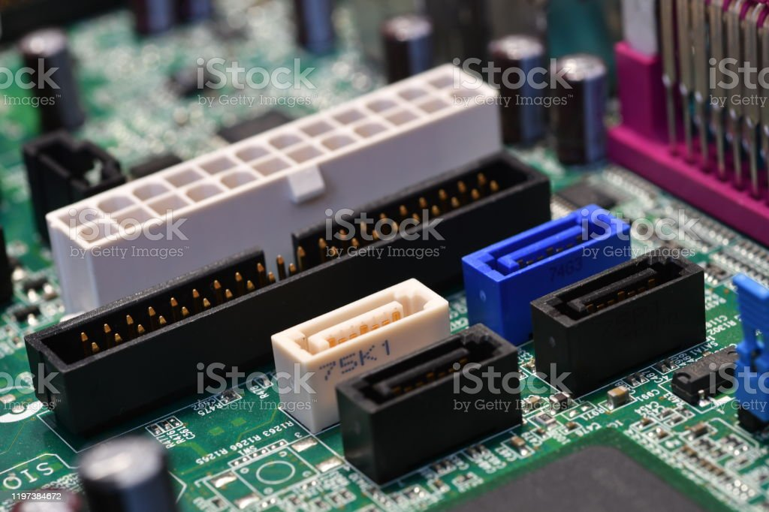
SATA Ports
These ports are used to connect storage devices, such as hard drives and solid-state drives (SSDs), to the motherboard.

Slide 12
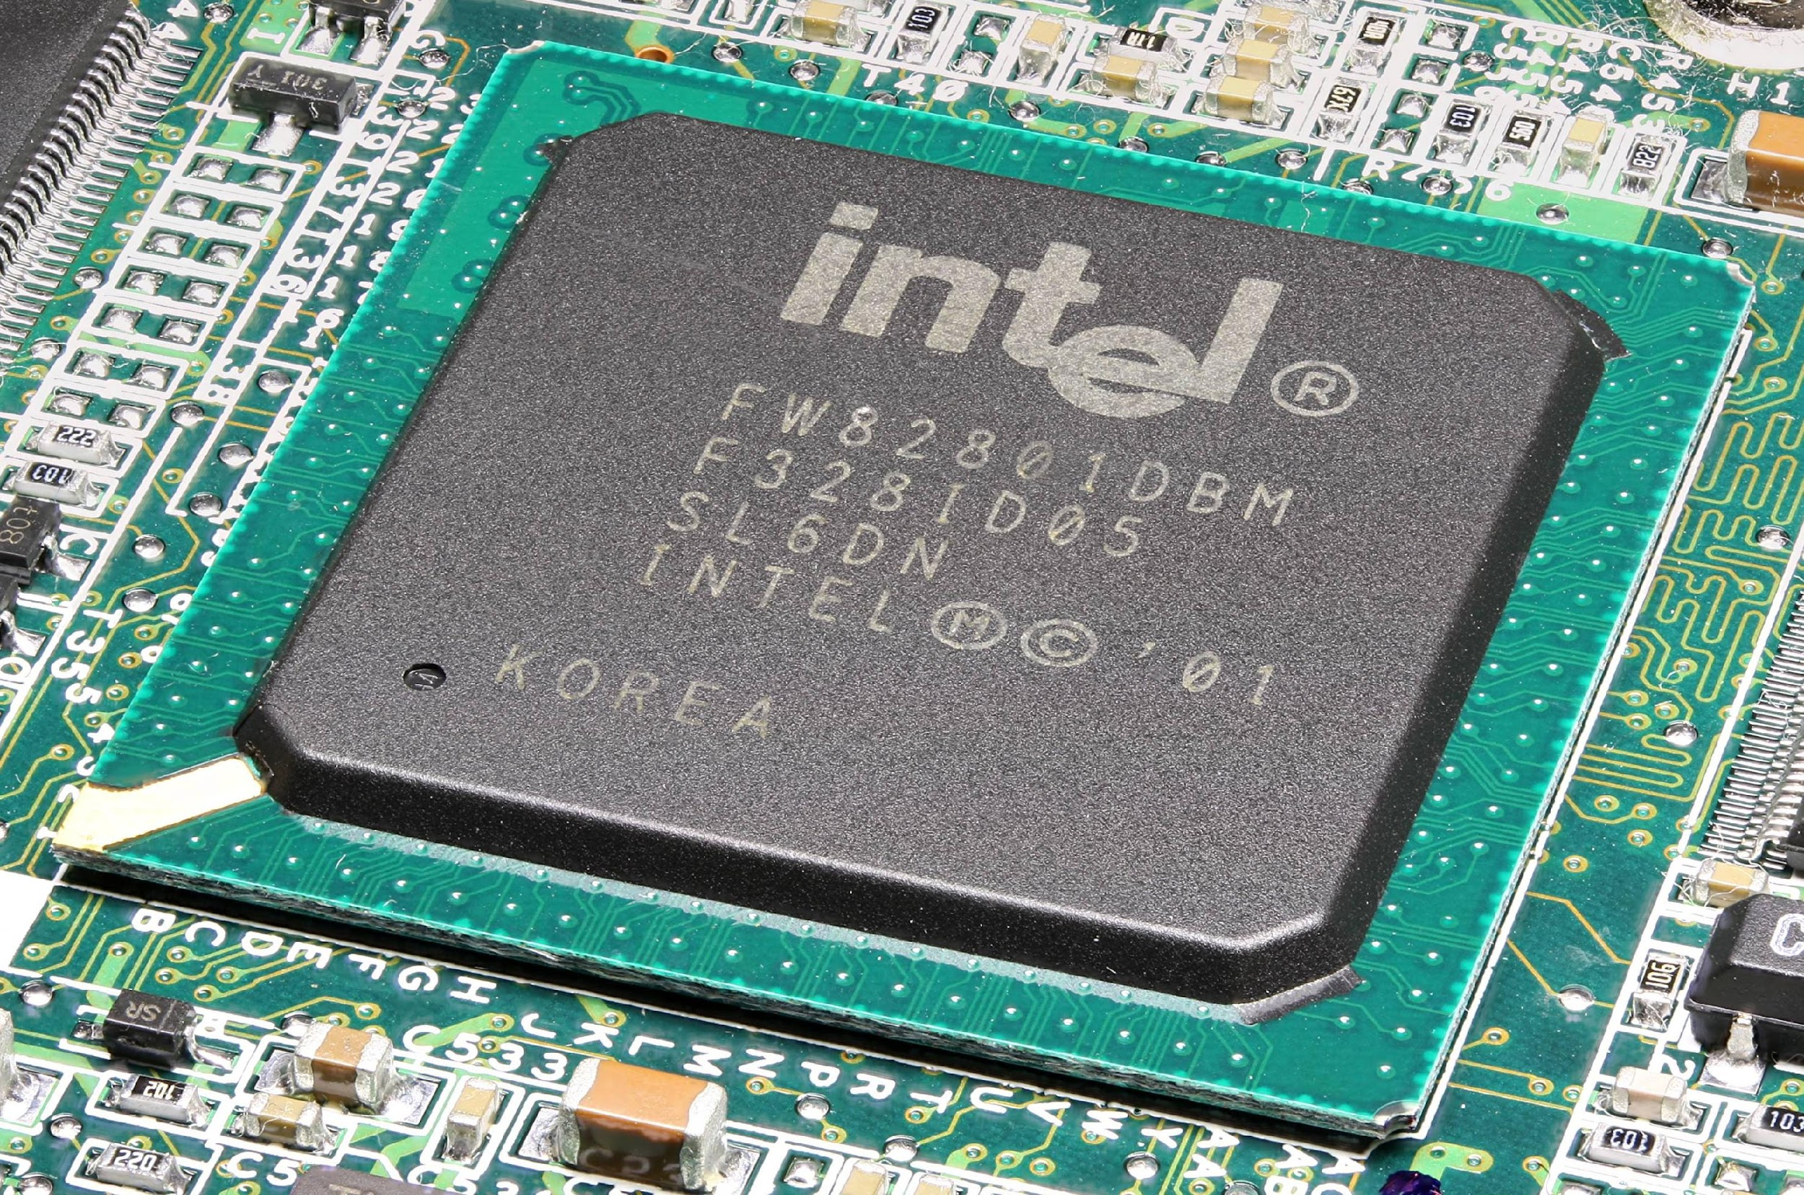
Chipset
The chipset manages the communication between the CPU, RAM, expansion cards, and other components on the motherboard.

Slide 13
03
CONCLUSION

Slide 14
CONCLUSION
Choosing the right motherboard is crucial for building a stable and reliable computer system, and it depends on factors such as the intended use, type of CPU and RAM, and number and types of expansion cards needed. Overall, the motherboard plays a critical role in the overall functionality and performance of a computer system.
In conclusion, a motherboard is a central circuit board that connects all the components of a computer system. It serves as a backbone and enables communication between various devices such as the CPU, RAM, storage devices, and expansion cards. The motherboard contains important components such as the chipset, BIOS, and power regulators that ensure proper functionality of the system.

Slide 15
Operating System
End

